Slide 1
Chapter 6 - Arrays
Outline
6.1 Introduction
6.2 Arrays
6.3 Declaring Arrays
6.4 Examples Using Arrays
6.5 Passing Arrays to Functions
6.6 Sorting Arrays
6.7 Case Study: Computing Mean, Median and Mode Using Arrays
6.8 Searching Arrays
6.9 Multiple-Subscripted Arrays

Slide 2
Objectives
In this chapter, you will learn:
  To introduce the array data structure.
  To understand the use of arrays to store, sort and search lists and tables of values.
  To understand how to define an array, initialize an array and refer to individual elements of an array.
  To be able to pass arrays to functions.
  To understand basic sorting techniques.
  To be able to define and manipulate multiple subscript arrays.

Slide 3
6.1 Introduction
Arrays
  Structures of related data items
  Static entity – same size throughout program
  Dynamic data structures discussed in Chapter 12

Slide 4
6.2 Arrays
Name of array (Note that all elements of this array have the same name, c)
Array
  Group of consecutive memory locations
  Same name and type
To refer to an element, specify
  Array name
  Position number
Format:
    arrayname[ position number ]
  First element at position 0
  n element array named c:
    c[ 0 ], c[ 1 ]...c[ n – 1 ]
c[0]
-45
c[1]
6
c[2]
0
c[3]
72
c[4]
1543
c[5]
-89
c[6]
0
c[7]
62
c[8]
-3
c[9]
1
c[10]
6453
c[11]
78
Position number of the element within array c

Slide 5
6.2 Arrays
Array elements are like normal variables
    c[ 0 ] = 3;
    printf( "%d", c[ 0 ] );
  Perform operations in subscript. If x equals 3
    c[ 5 - 2 ] == c[ 3 ] == c[ x ]

Slide 6
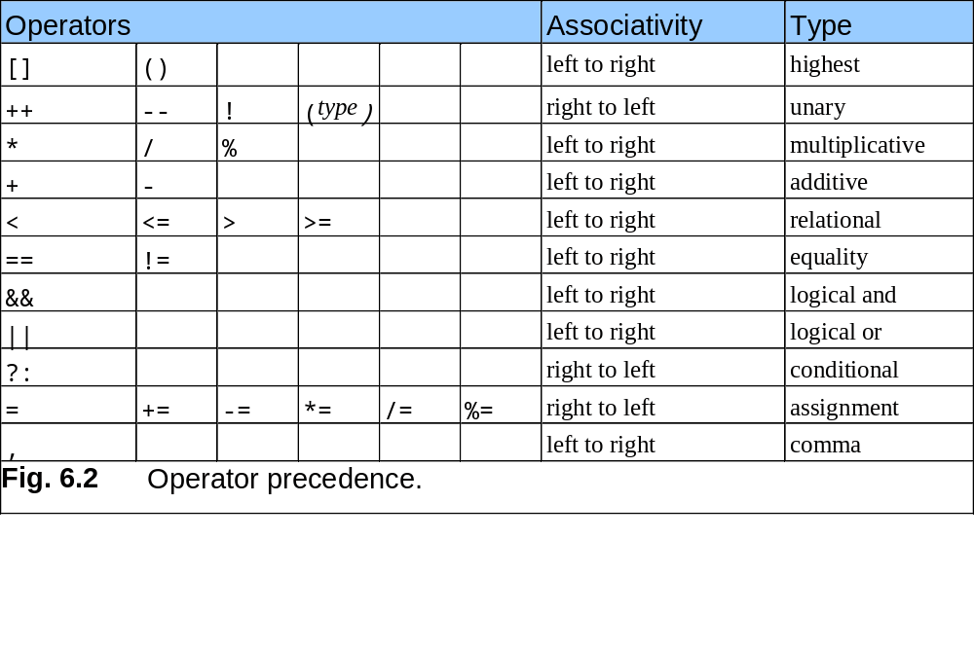
6.2 Arrays

Slide 7
6.3 Defining Arrays
When defining arrays, specify
  Name
  Type of array
  Number of elements
    arrayType arrayName[ numberOfElements ];
  Examples:
    int c[ 10 ];
    float myArray[ 3284 ];
Defining multiple arrays of same type
  Format similar to regular variables
  Example:
    int b[ 100 ], x[ 27 ];

Slide 8
6.4 Examples Using Arrays
Initializers
    int n[ 5 ] = { 1, 2, 3, 4, 5 };
  If not enough initializers, rightmost elements become 0
      int n[ 5 ] = { 0 }
    All elements 0
  If too many a syntax error is produced syntax error
  C arrays have no bounds checking
If size omitted, initializers determine it
    int n[ ] = { 1, 2, 3, 4, 5 };
  5 initializers, therefore 5 element array

Slide 9
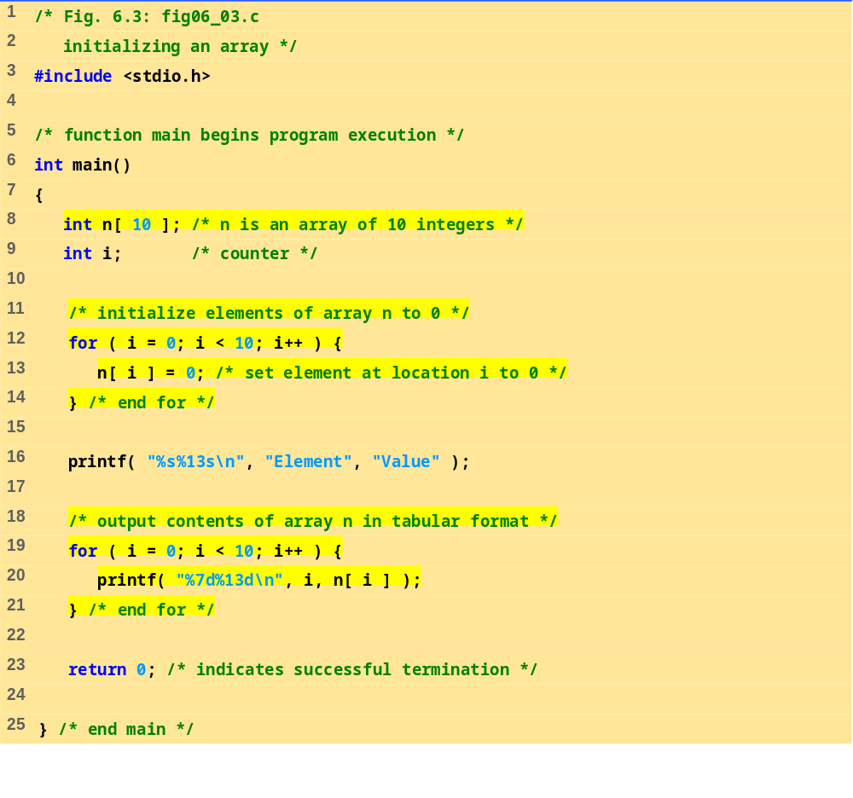
fig06_03.c

Slide 10
Element Value
0 0
1 0
2 0
3 0
4 0
5 0
6 0
7 0
8 0
9 0
Program Output

Slide 11
6.4 Examples Using Arrays
Character arrays
  String “first” is really a static array of characters
  Character arrays can be initialized using string literals
      char string1[] = "first";
    Null character '\0' terminates strings
    string1 actually has 6 elements
      It is equivalent to
  char string1[] = { 'f', 'i', 'r', 's', 't', '\0' };
  Can access individual characters
    string1[ 3 ] is character ‘s’
  Array name is address of array, so & not needed for scanf
      scanf( "%s", string2 );
    Reads characters until whitespace encountered
    Can write beyond end of array, be careful

Slide 12
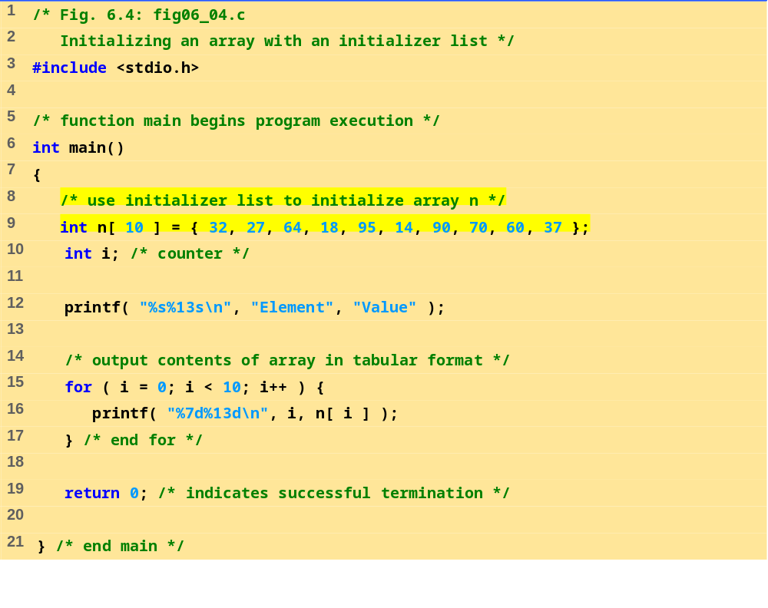
fig06_04.c

Slide 13
Program Output
Element Value
0 32
1 27
2 64
3 18
4 95
5 14
6 90
7 70
8 60
9 37

Slide 14
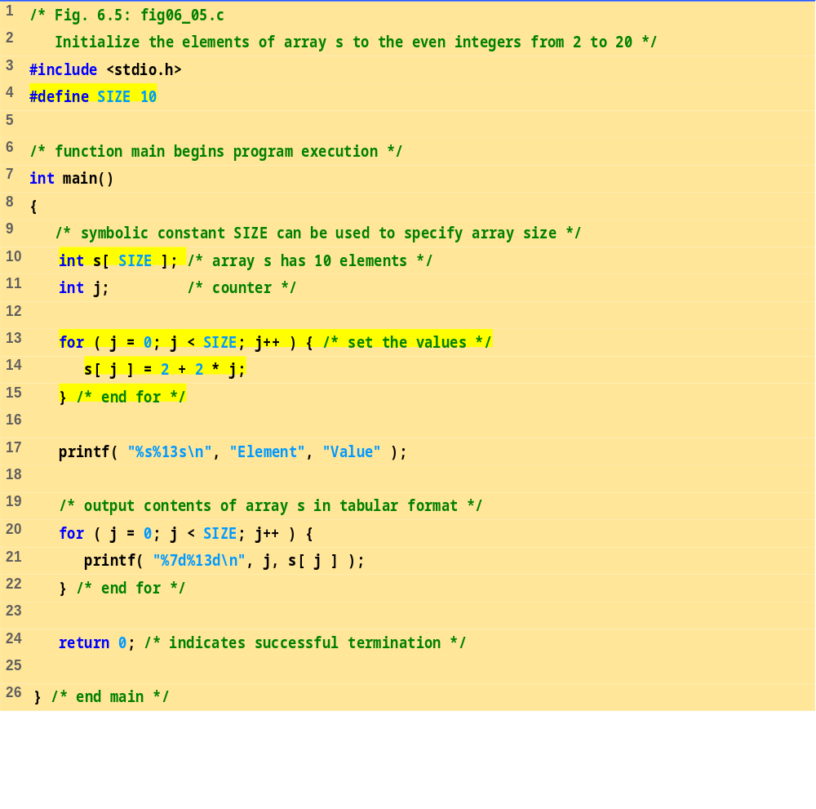
fig06_05.c

Slide 15
Program Output
Element Value
0 2
1 4
2 6
3 8
4 10
5 12
6 14
7 16
8 18
9 20

Slide 16
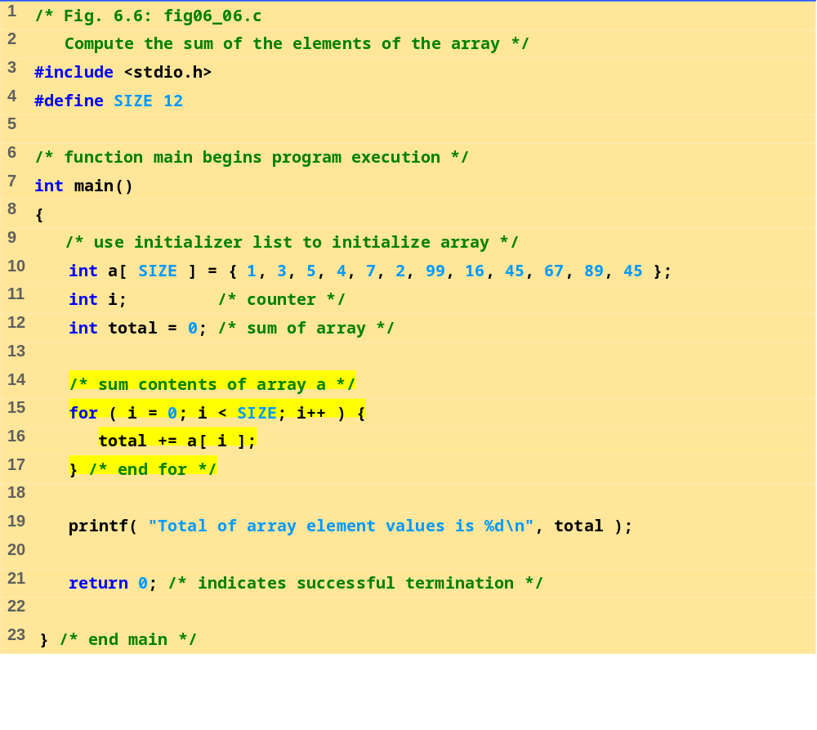
fig06_06.c
Program Output
Total of array element values is 383

Slide 17
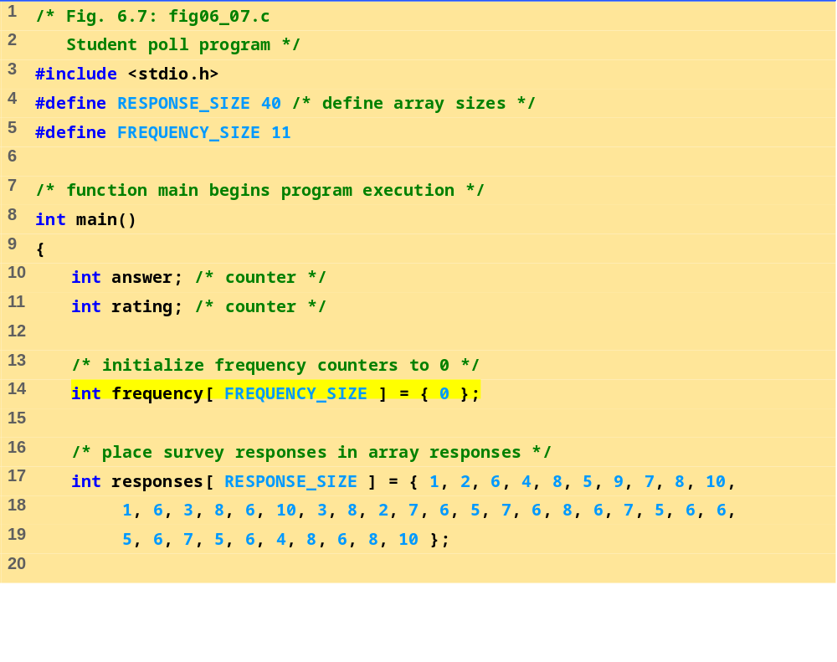
fig06_07.c (Part 1 of 2)

Slide 18
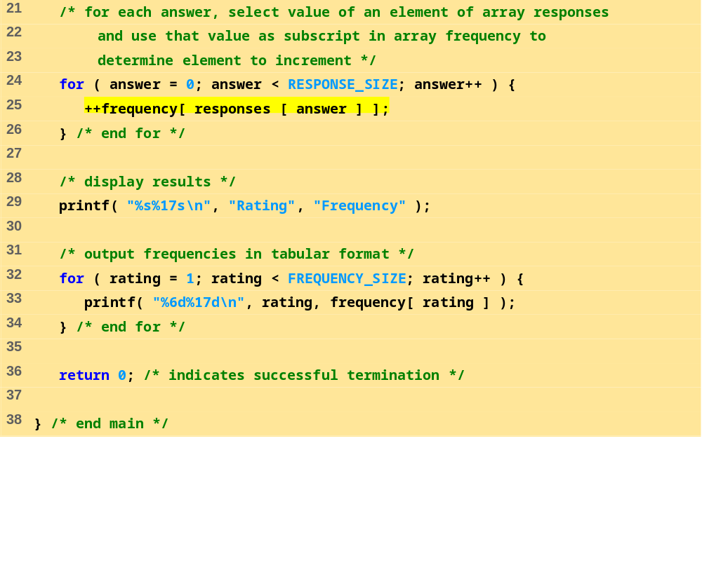
fig06_07.c (Part 2 of 2)
Program Output
Rating Frequency
1 2
2 2
3 2
4 2
5 5
6 11
7 5
8 7
9 1
10 3

Slide 19
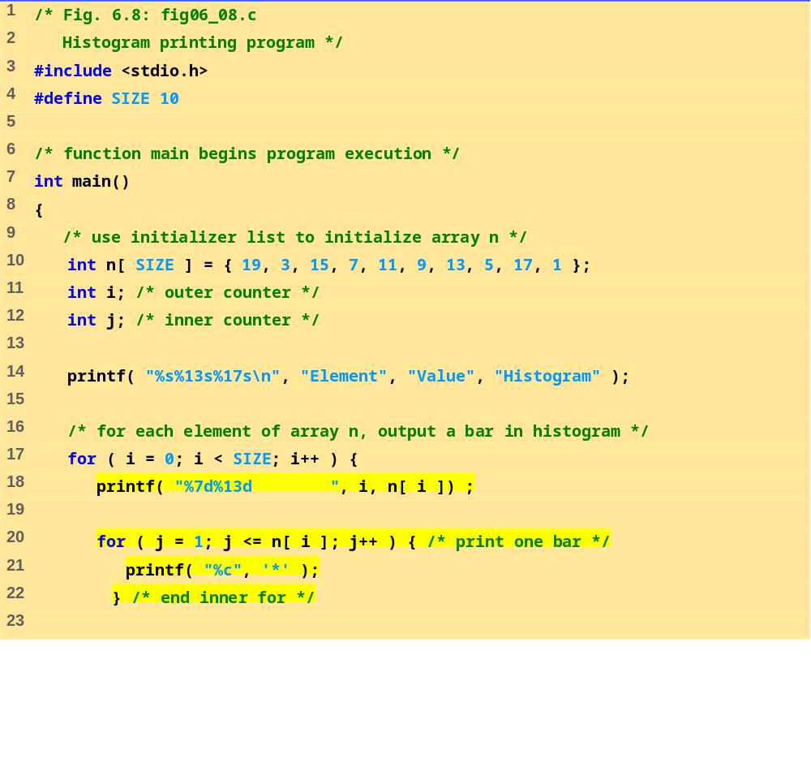
fig06_08.c (Part 1 of 2)

Slide 20
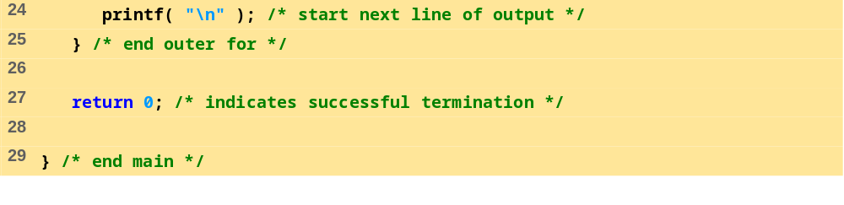
fig06_08.c (Part 2 of 2)
Program Output
Element Value Histogram
0 19 *******************
1 3 ***
2 15 ***************
3 7 *******
4 11 ***********
5 9 *********
6 13 *************
7 5 *****
8 17 *****************
9 1 *

Slide 21
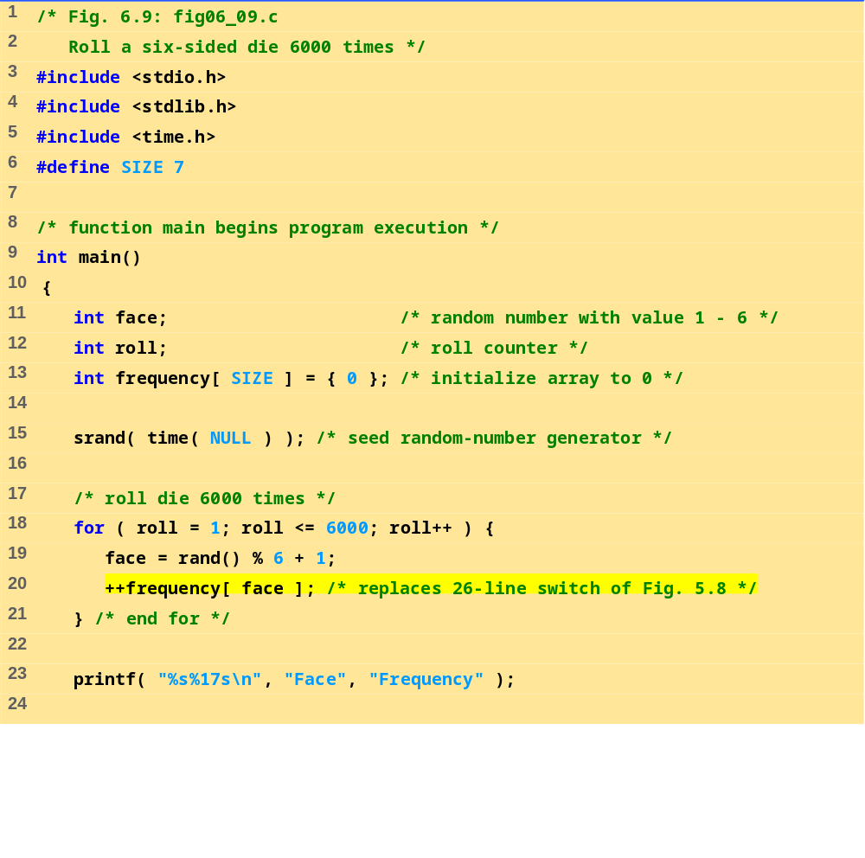
fig06_09.c (Part 1 of 2)

Slide 22
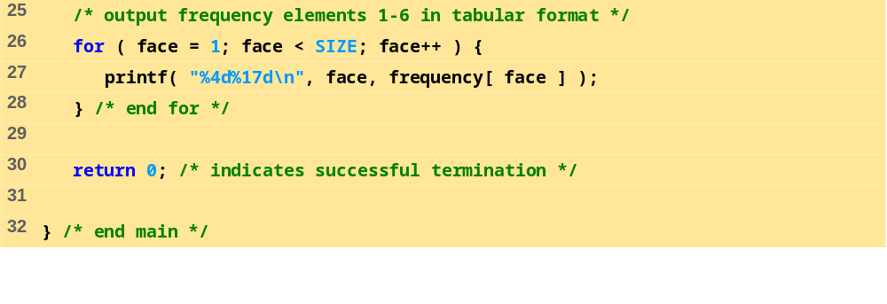
fig06_09.c (Part 2 of 2)
Program Output
Face Frequency
1 1029
2 951
3 987
4 1033
5 1010
6 990

Slide 23
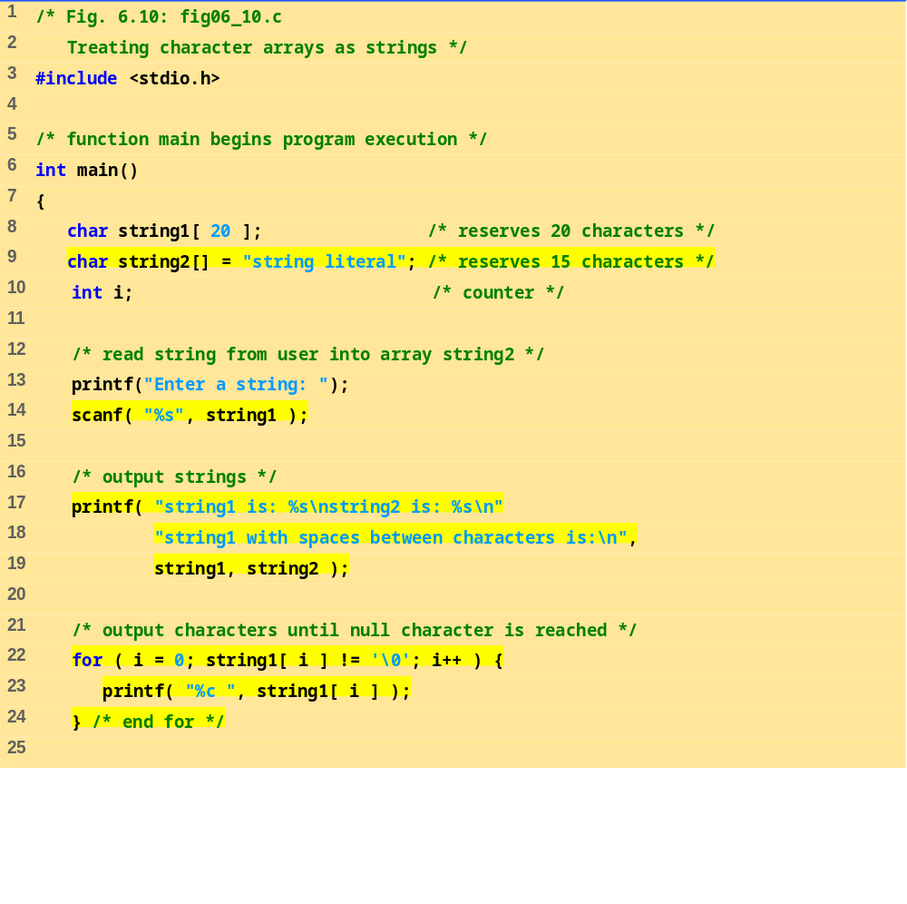
fig06_10.c (Part 1 of 2)

Slide 24
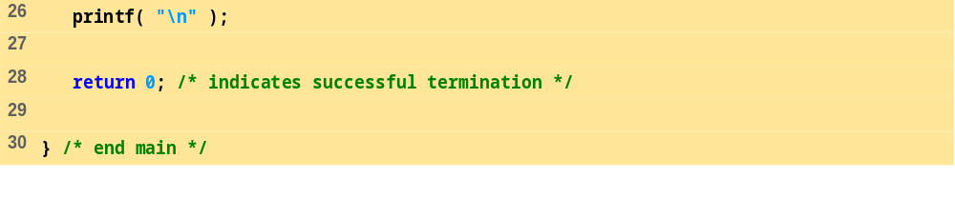
fig06_10.c (Part 2 of 2)
Enter a string: Hello there
string1 is: Hello
string2 is: string literal
string1 with spaces between characters is:
H e l l o

Slide 25
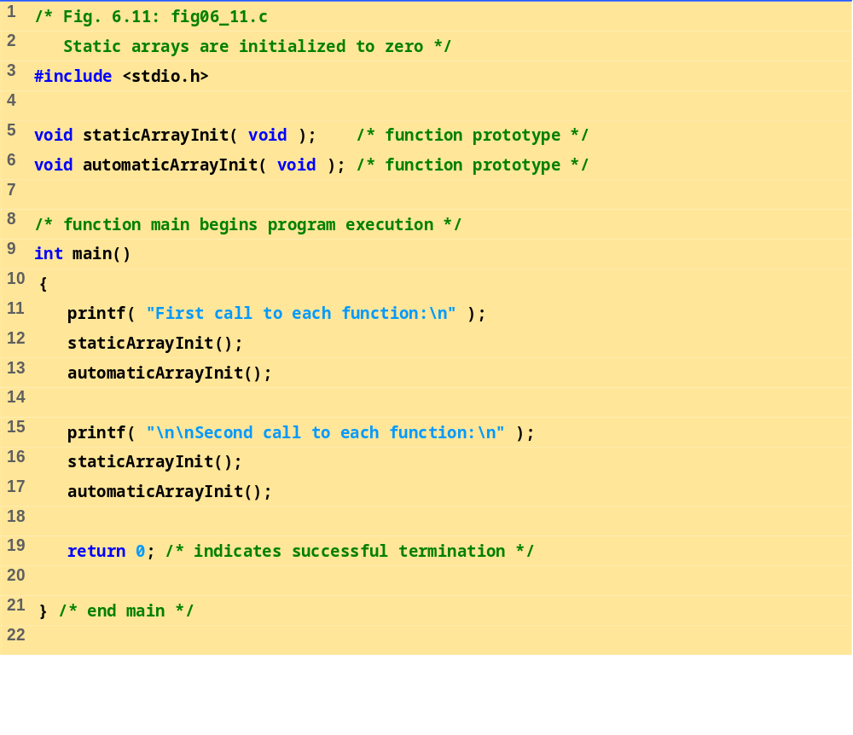
fig06_11.c (Part 1 of 3)

Slide 26
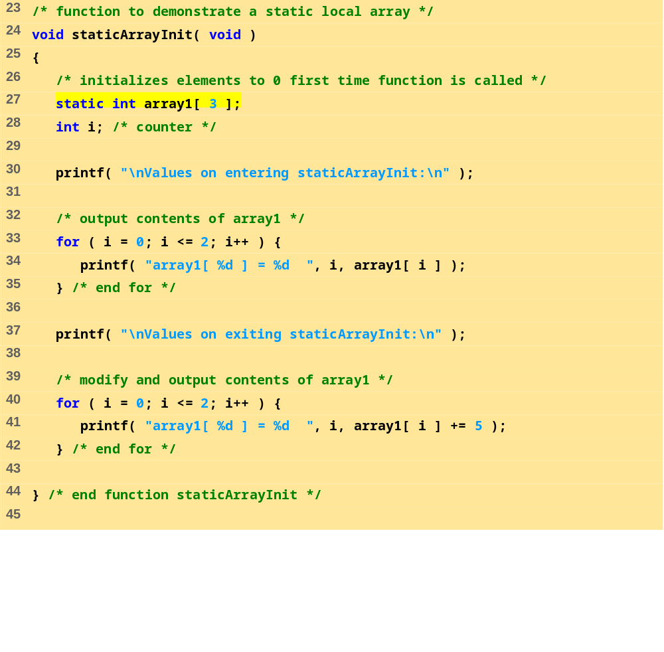
fig06_11.c (Part 2 of 3)

Slide 27
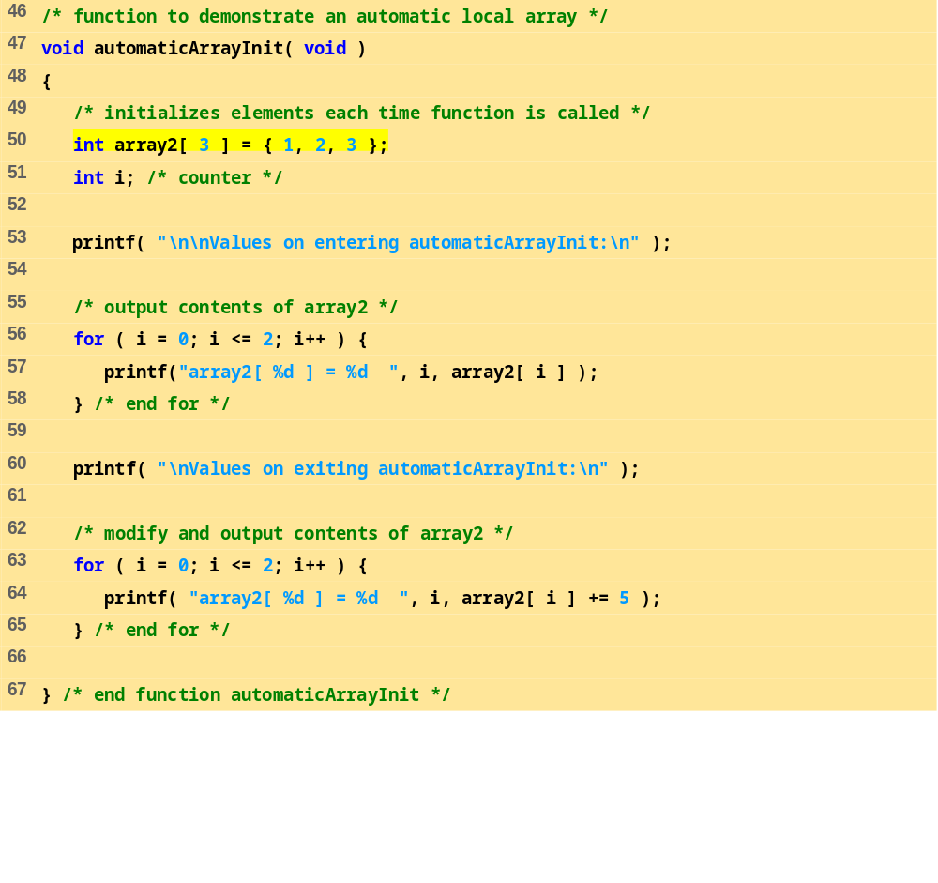
fig06_11.c (Part 3 of 3)

Slide 28
Program Output
First call to each function:
Values on entering staticArrayInit:
array1[ 0 ] = 0 array1[ 1 ] = 0 array1[ 2 ] = 0
Values on exiting staticArrayInit:
array1[ 0 ] = 5 array1[ 1 ] = 5 array1[ 2 ] = 5
Values on entering automaticArrayInit:
array2[ 0 ] = 1 array2[ 1 ] = 2 array2[ 2 ] = 3
Values on exiting automaticArrayInit:
array2[ 0 ] = 6 array2[ 1 ] = 7 array2[ 2 ] = 8
Second call to each function:
Values on entering staticArrayInit:
array1[ 0 ] = 5 array1[ 1 ] = 5 array1[ 2 ] = 5
Values on exiting staticArrayInit:
array1[ 0 ] = 10 array1[ 1 ] = 10 array1[ 2 ] = 10
Values on entering automaticArrayInit:
array2[ 0 ] = 1 array2[ 1 ] = 2 array2[ 2 ] = 3
Values on exiting automaticArrayInit:
array2[ 0 ] = 6 array2[ 1 ] = 7 array2[ 2 ] = 8

Slide 29
6.5 Passing Arrays to Functions
Passing arrays
  To pass an array argument to a function, specify the name of the array without any brackets
      int myArray[ 24 ];
      myFunction( myArray, 24 );
    Array size usually passed to function
  Arrays passed call-by-reference
  Name of array is address of first element
  Function knows where the array is stored
    Modifies original memory locations
Passing array elements
  Passed by call-by-value
  Pass subscripted name (i.e., myArray[ 3 ]) to function

Slide 30
6.5 Passing Arrays to Functions
Function prototype
    void modifyArray( int b[], int arraySize );
  Parameter names optional in prototype
    int b[] could be written int []
    int arraySize could be simply int

Slide 31
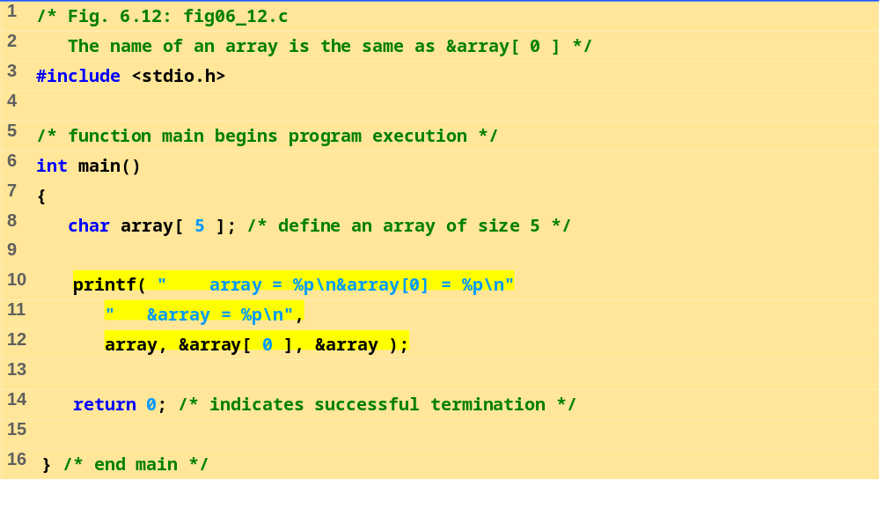
fig06_12.c
Program Output
array = 0012FF78
&array[0] = 0012FF78
&array = 0012FF78

Slide 32
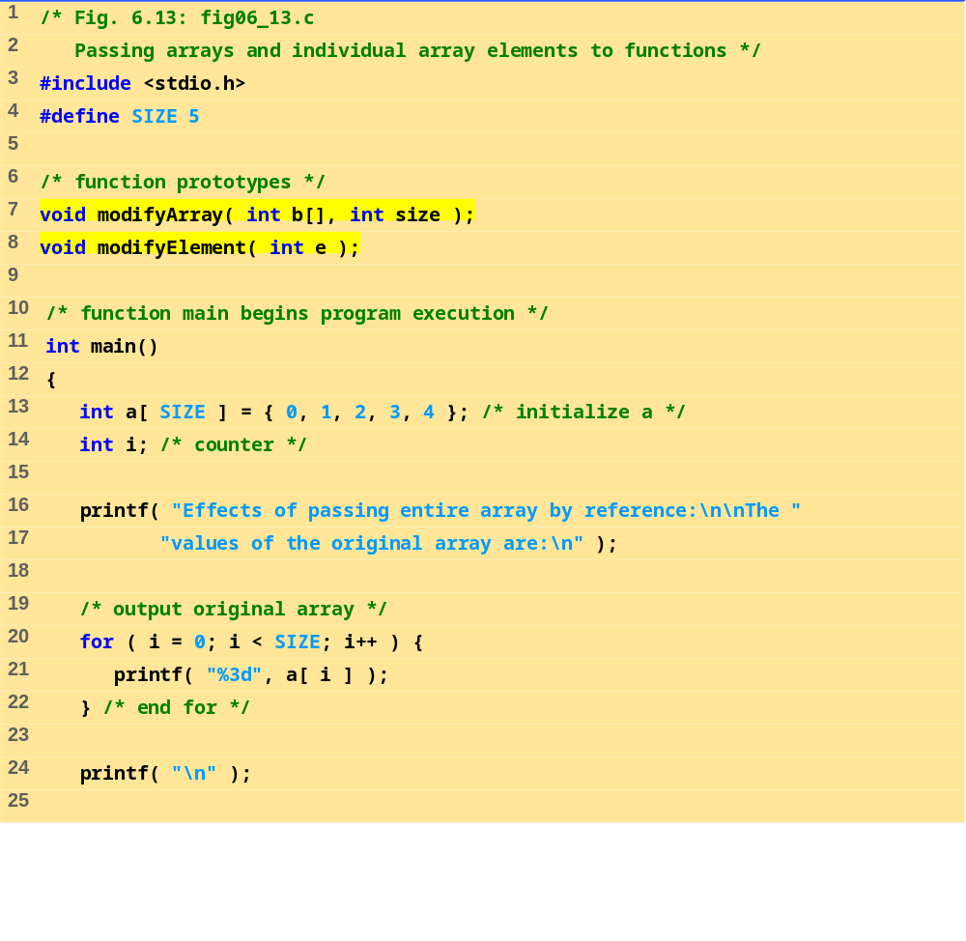
fig06_13.c (Part 1 of 3)

Slide 33
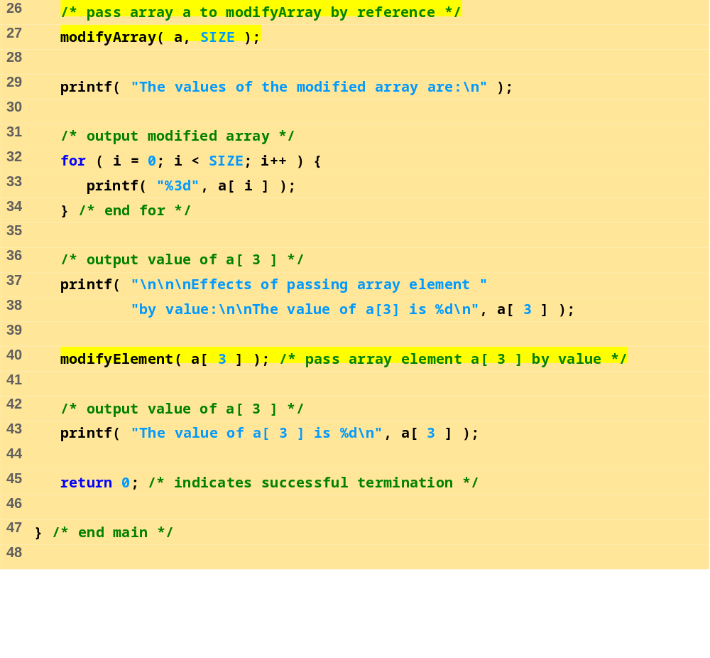
fig06_13.c (Part 2 of 3)

Slide 34
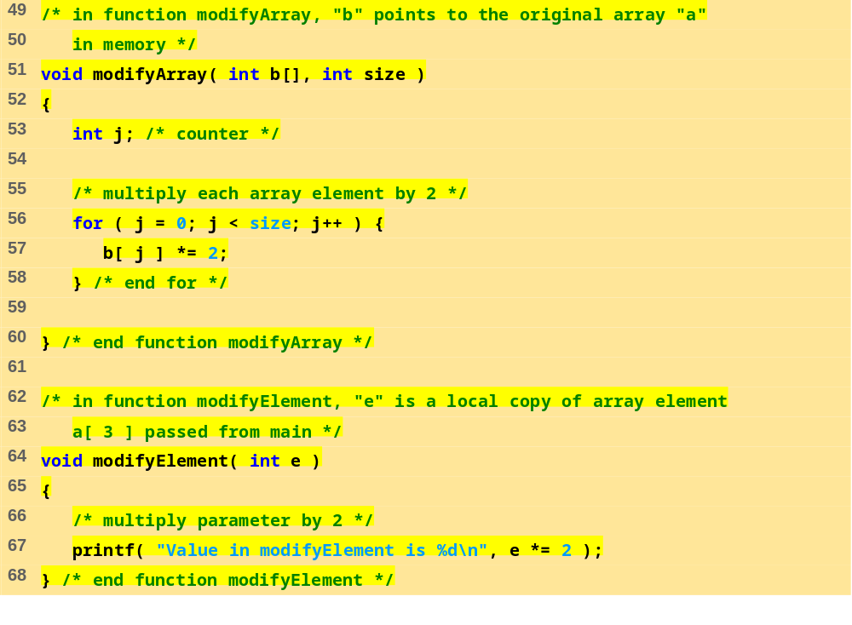
fig06_13.c (Part 3 of 3)

Slide 35
Program Output
Effects of passing entire array by reference:
The values of the original array are:
0 1 2 3 4
The values of the modified array are:
0 2 4 6 8
Effects of passing array element by value:
The value of a[3] is 6
Value in modifyElement is 12
The value of a[ 3 ] is 6

Slide 36
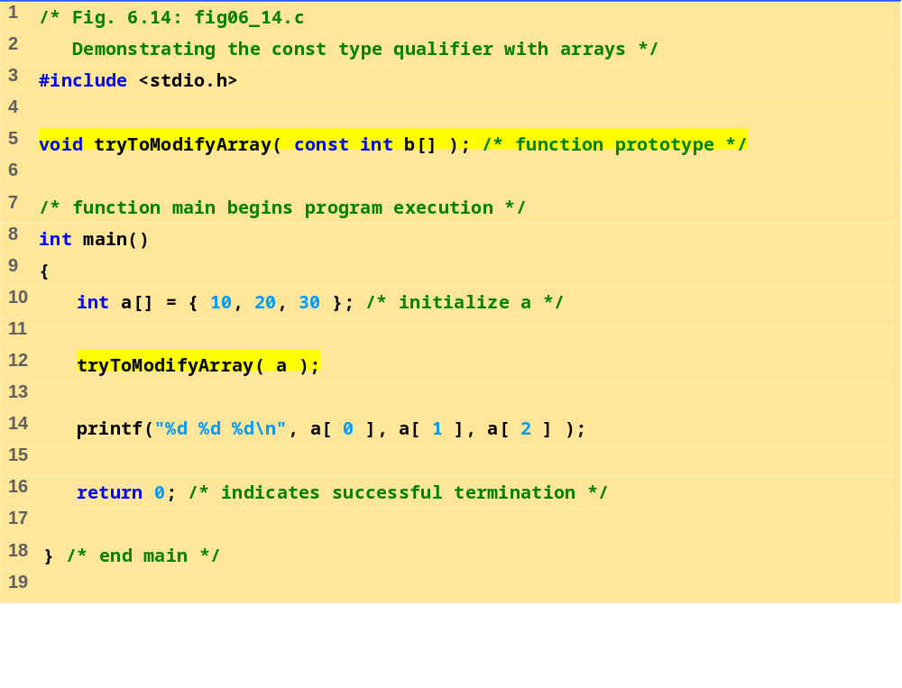
fig06_14.c (Part 1 of 2)

Slide 37
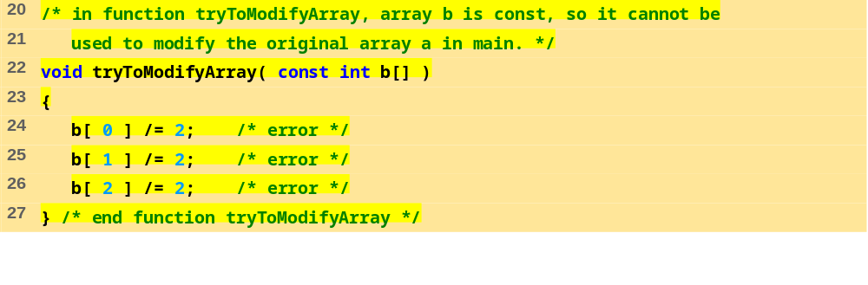
fig06_14.c (Part 2 of 2)
Program Output
Compiling...
FIG06_14.C
fig06_14.c(24) : error C2166: l-value specifies const object
fig06_14.c(25) : error C2166: l-value specifies const object
fig06_14.c(26) : error C2166: l-value specifies const object

Slide 38
6.6 Sorting Arrays
Sorting data
  Important computing application
  Virtually every organization must sort some data
Bubble sort (sinking sort)
  Several passes through the array
  Successive pairs of elements are compared
    If increasing order (or identical ), no change
    If decreasing order, elements exchanged
  Repeat
Example:
  original: 3 4 2 6 7
  pass 1: 3 2 4 6 7
  pass 2: 2 3 4 6 7
  Small elements "bubble" to the top

Slide 39
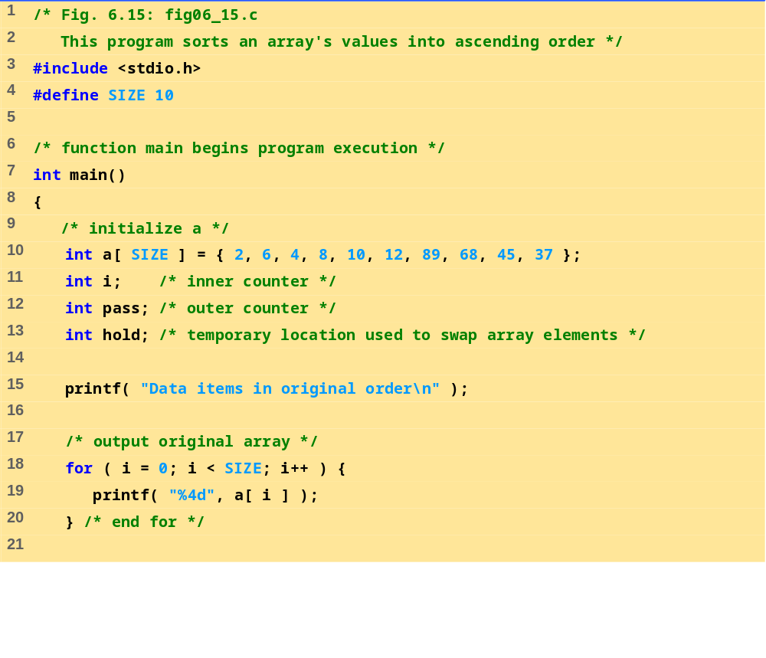
fig06_15.c (Part 1 of 3)

Slide 40
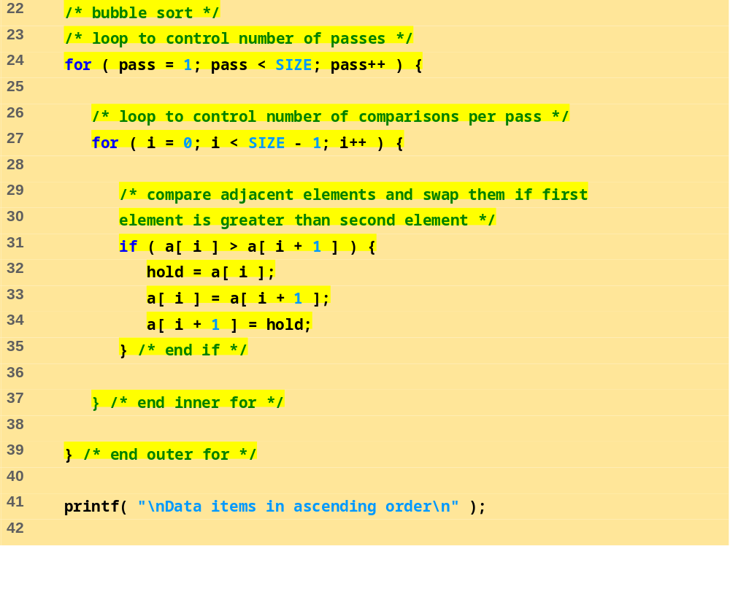
fig06_15.c (Part 2 of 3)

Slide 41
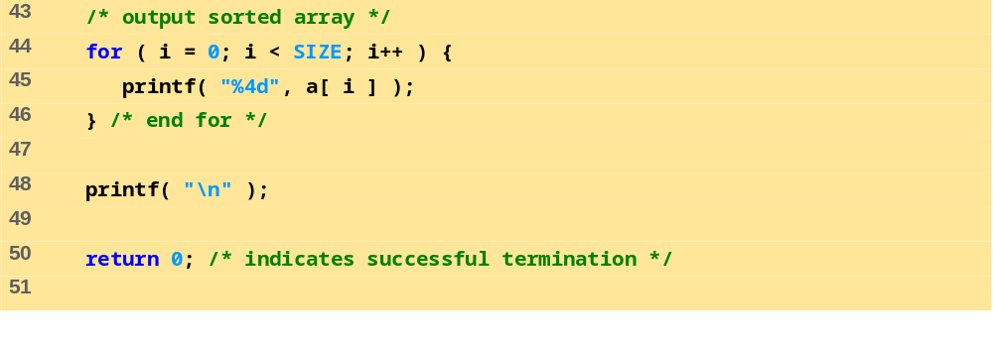
fig06_15.c (Part 3 of 3)
Program Output
Data items in original order
2 6 4 8 10 12 89 68 45 37
Data items in ascending order
2 4 6 8 10 12 37 45 68 89

Slide 42
6.7 Case Study: Computing Mean, Median and Mode Using Arrays
Mean – average
Median – number in middle of sorted list
  1, 2, 3, 4, 5
  3 is the median
Mode – number that occurs most often
  1, 1, 1, 2, 3, 3, 4, 5
  1 is the mode

Slide 43
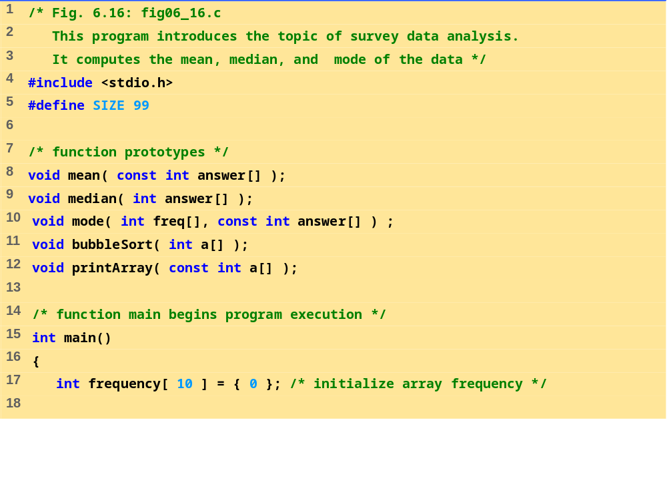
fig06_16.c (Part 1 of 8)

Slide 44
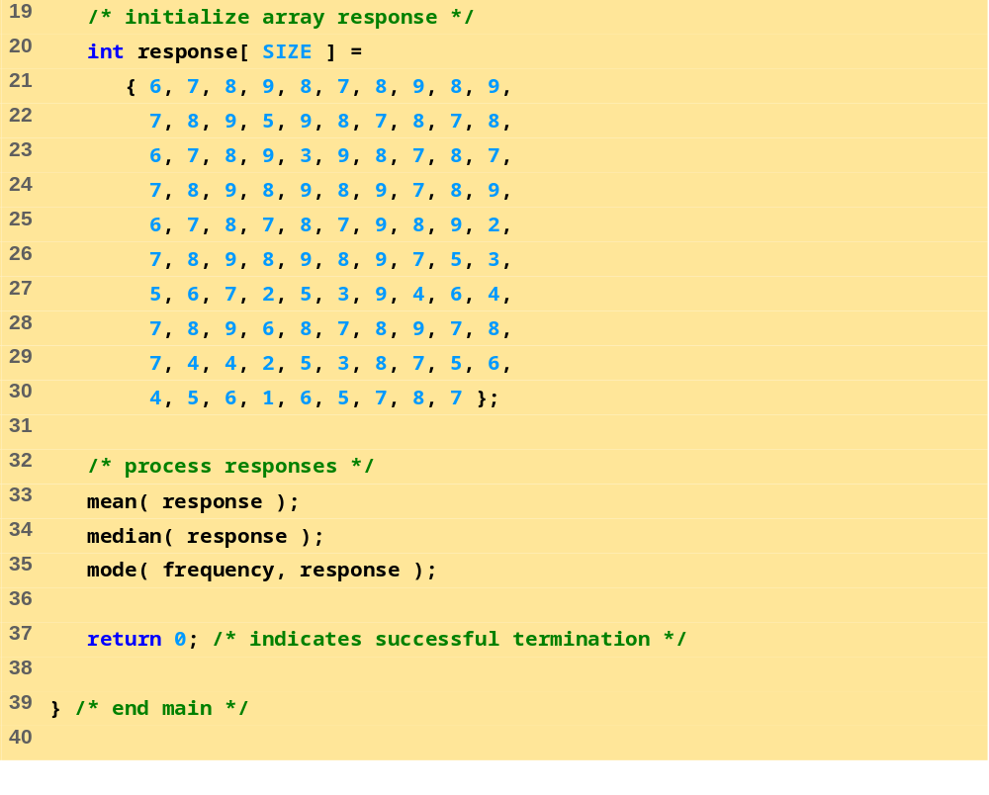
fig06_16.c (Part 2 of 8)

Slide 45
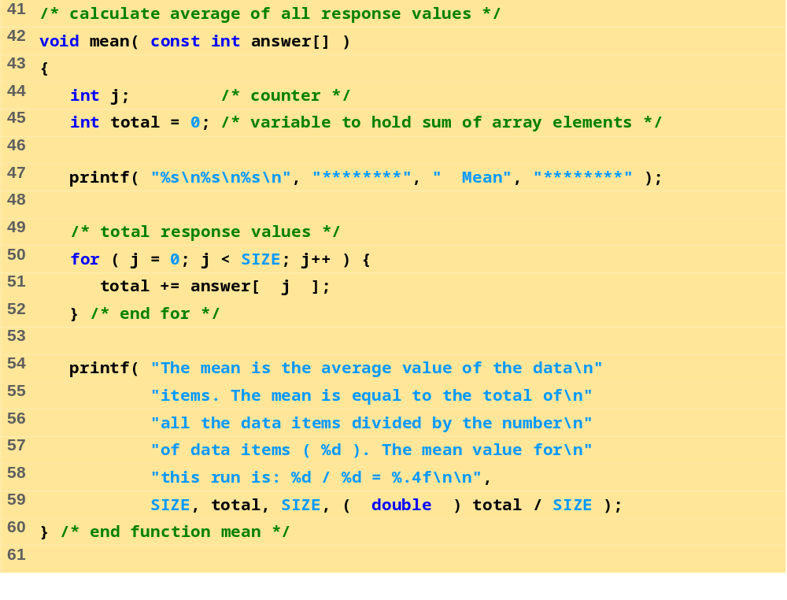
fig06_16.c (Part 3 of 8)

Slide 46
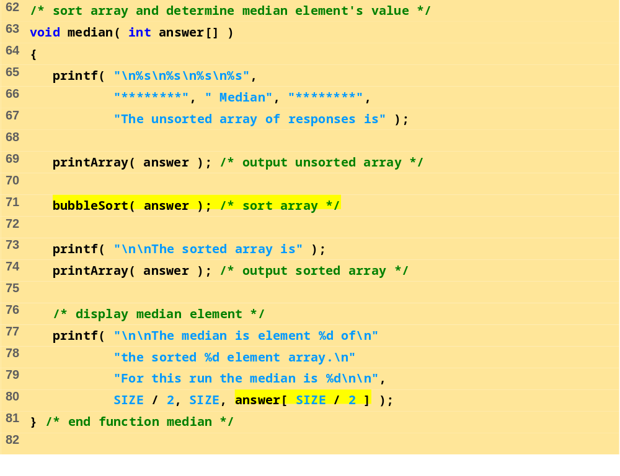
fig06_16.c (Part 4 of 8)

Slide 47
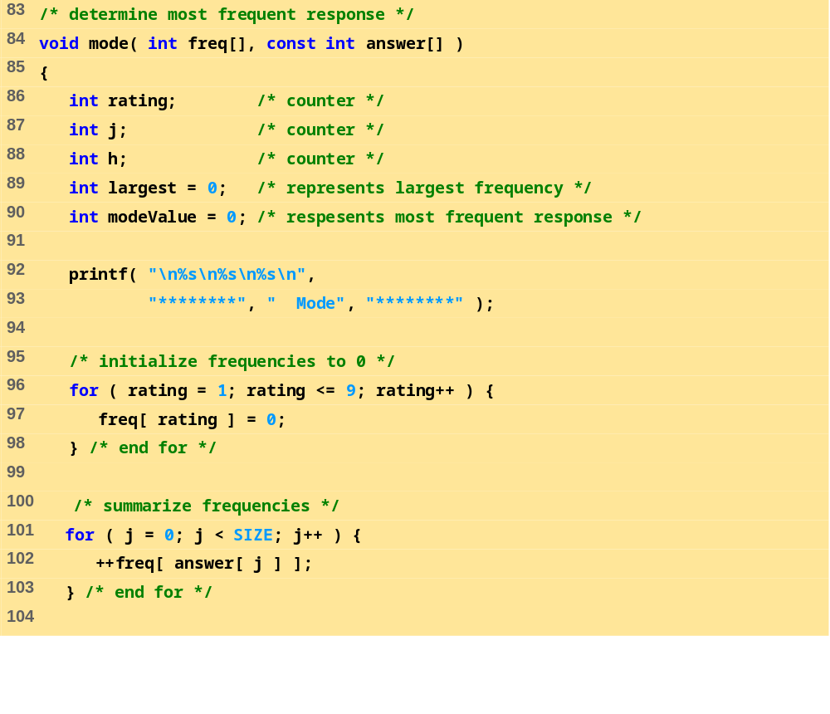
fig06_16.c (Part 5 of 8)

Slide 48
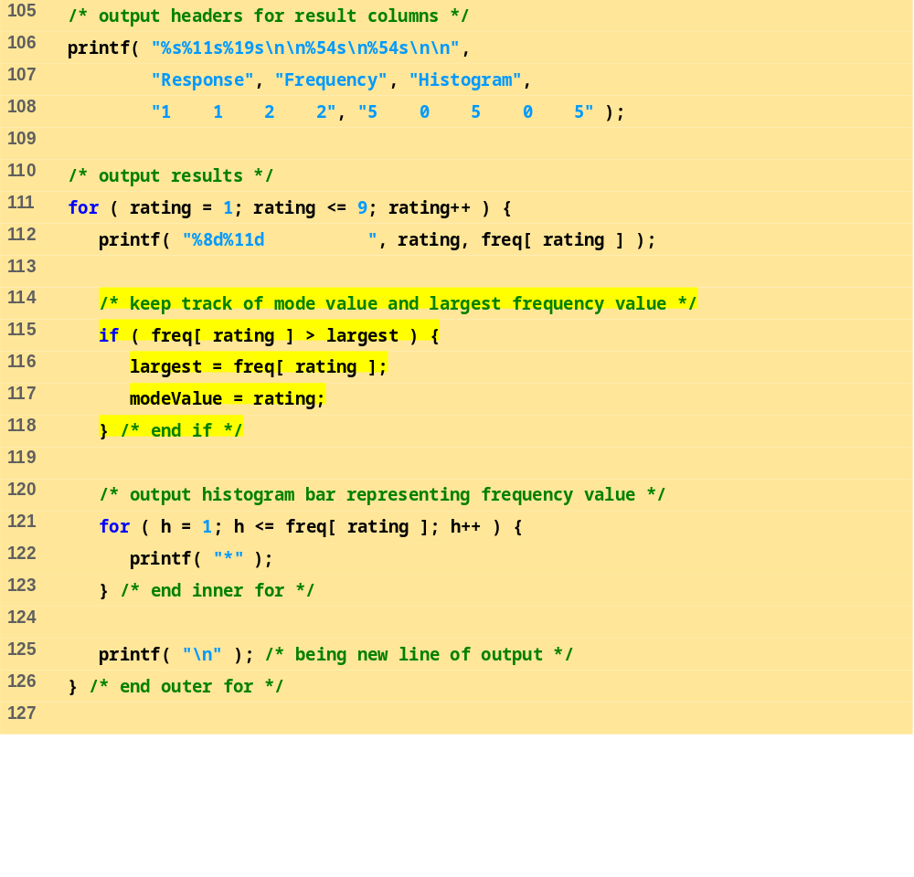
fig06_16.c (Part 6 of 8)

Slide 49
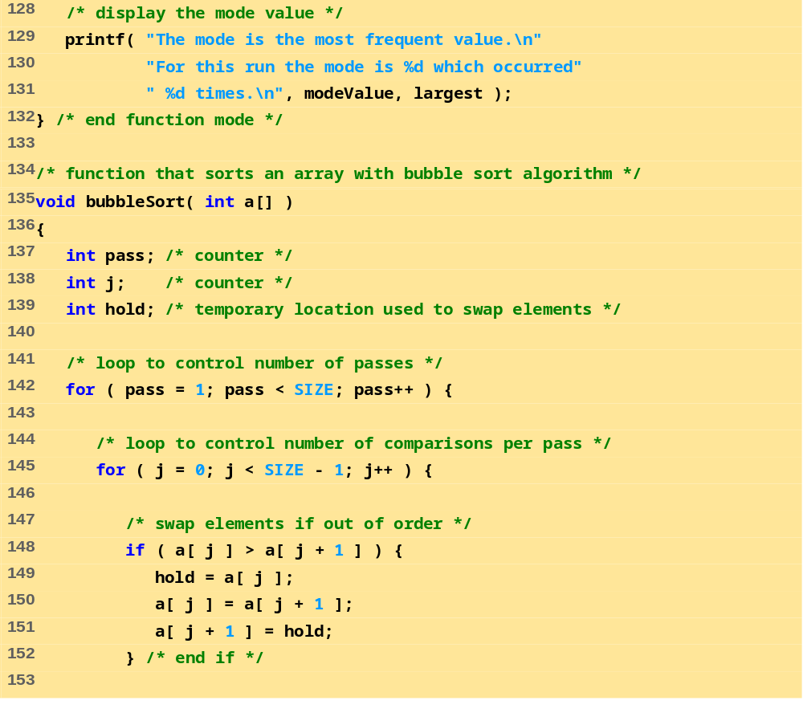
fig06_16.c (Part 7 of 8)

Slide 50
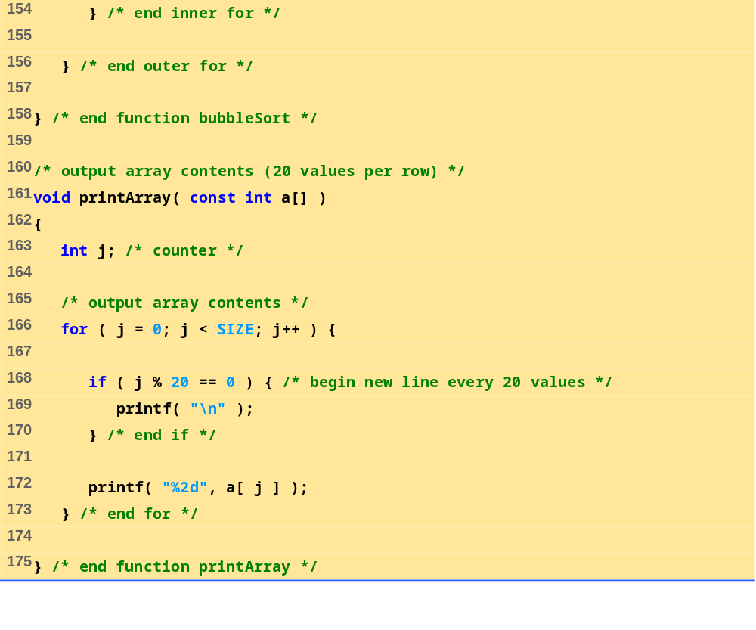
fig06_16.c (Part 8 of 8)

Slide 51
Program Output
********
Mean
********
The mean is the average value of the data
items. The mean is equal to the total of
all the data items divided by the number
of data items ( 99 ). The mean value for
this run is: 681 / 99 = 6.8788
********
Median
********
The unsorted array of responses is
6 7 8 9 8 7 8 9 8 9 7 8 9 5 9 8 7 8 7 8
6 7 8 9 3 9 8 7 8 7 7 8 9 8 9 8 9 7 8 9
6 7 8 7 8 7 9 8 9 2 7 8 9 8 9 8 9 7 5 3
5 6 7 2 5 3 9 4 6 4 7 8 9 6 8 7 8 9 7 8
7 4 4 2 5 3 8 7 5 6 4 5 6 1 6 5 7 8 7
The sorted array is
1 2 2 2 3 3 3 3 4 4 4 4 4 5 5 5 5 5 5 5
5 6 6 6 6 6 6 6 6 6 7 7 7 7 7 7 7 7 7 7
7 7 7 7 7 7 7 7 7 7 7 7 7 8 8 8 8 8 8 8
8 8 8 8 8 8 8 8 8 8 8 8 8 8 8 8 8 8 8 8
9 9 9 9 9 9 9 9 9 9 9 9 9 9 9 9 9 9 9

Slide 52
Program Output (continued)
The median is element 49 of
the sorted 99 element array.
For this run the median is 7
********
Mode
********
Response Frequency Histogram
1 1 2 2
5 0 5 0 5
1 1 *
2 3 ***
3 4 ****
4 5 *****
5 8 ********
6 9 *********
7 23 ***********************
8 27 ***************************
9 19 *******************
The mode is the most frequent value.
For this run the mode is 8 which occurred 27 times.

Slide 53
6.8 Searching Arrays: Linear Search and Binary Search
Search an array for a key value
Linear search
  Simple
  Compare each element of array with key value
  Useful for small and unsorted arrays

Slide 54
6.8 Searching Arrays: Linear Search and Binary Search
Binary search
  For sorted arrays
  Compares middle element with key
    If equal, match found
    If key < middle, looks in first half of array
    If key > middle, looks in last half
    Repeat
  Very fast; at most n steps, where 2^{n} > number of elements
    30 element array takes at most 5 steps
      2⁵ > 30 so at most 5 steps

Slide 55
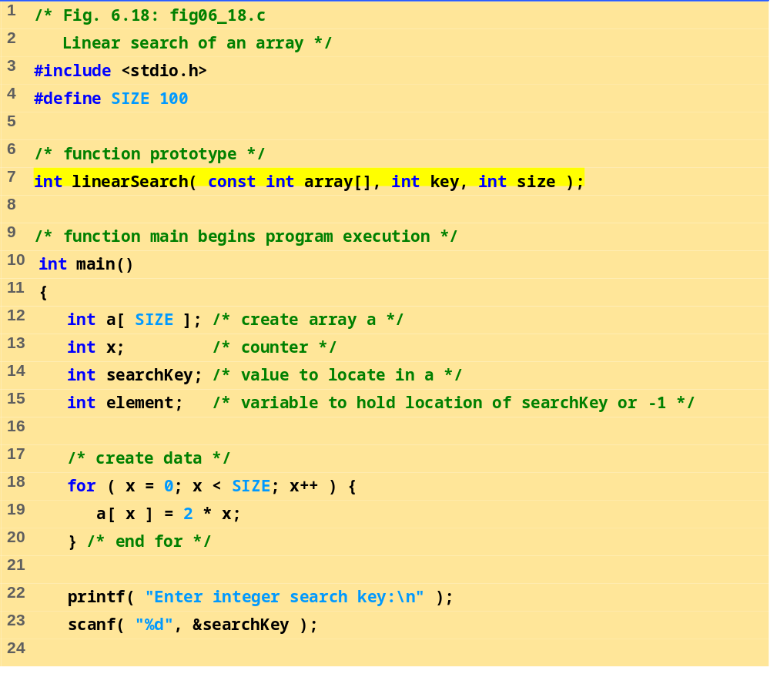
fig06_18.c (Part 1 of 3)

Slide 56
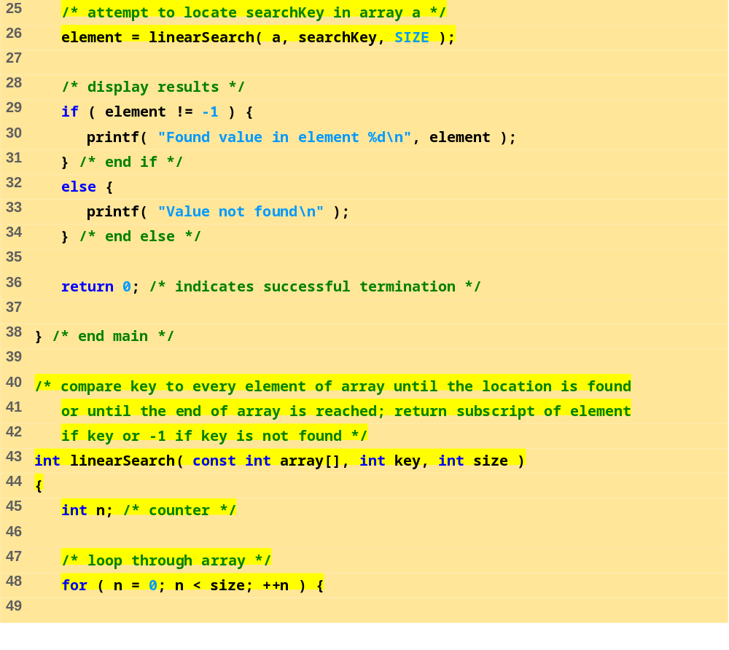
fig06_18.c (Part 2 of 3)

Slide 57
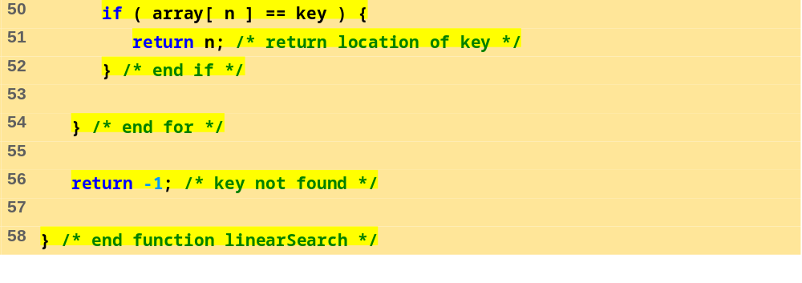
fig06_18.c (Part 3 of 3)
Program Output
Enter integer search key:
36
Found value in element 18
Enter integer search key:
37
Value not found

Slide 58
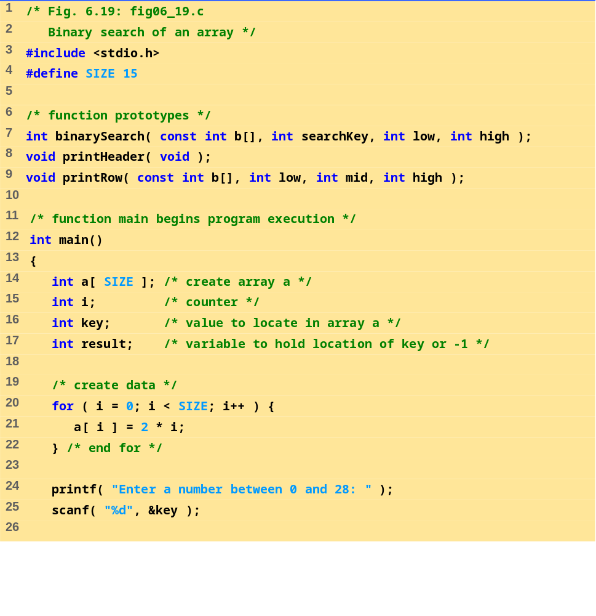
fig06_19.c (Part 1 of 5)

Slide 59
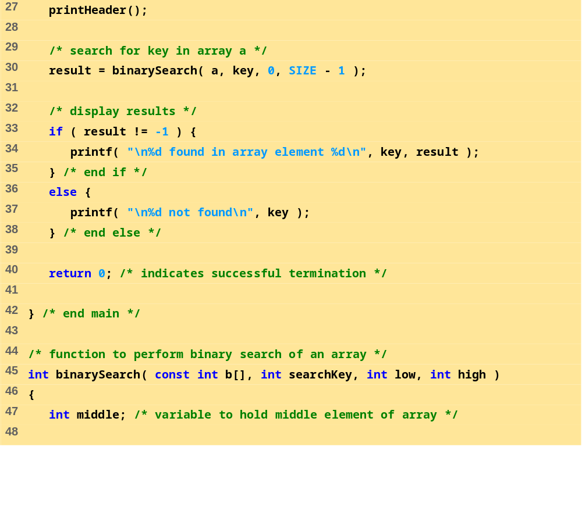
fig06_19.c (Part 2 of 5)

Slide 60
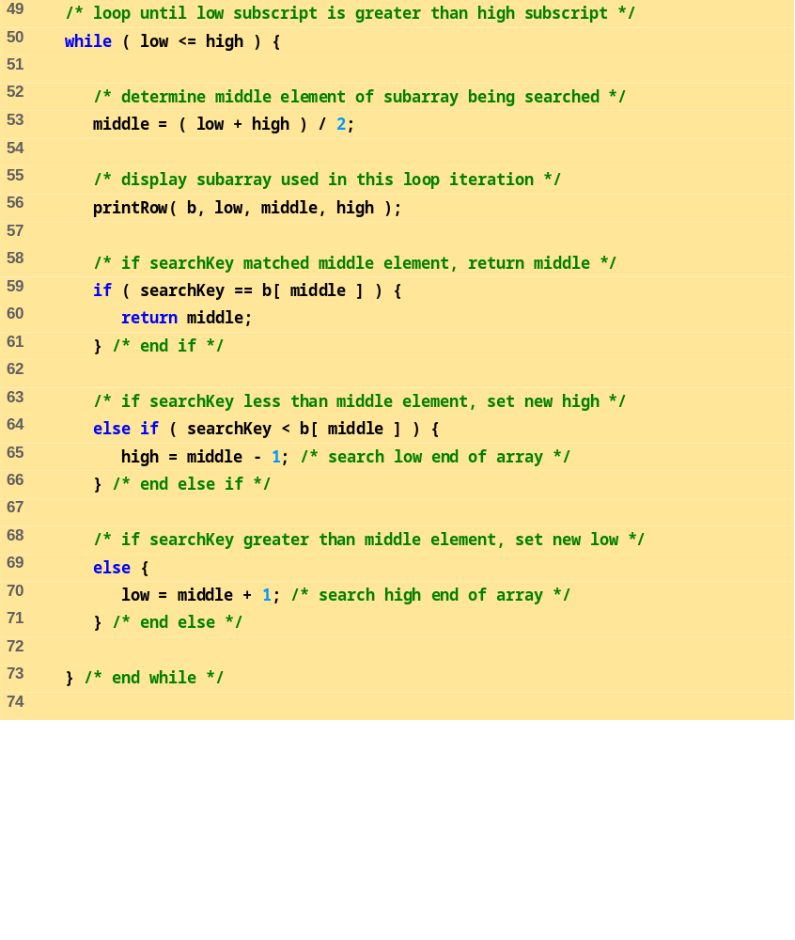
fig06_19.c (Part 3 of 5)

Slide 61
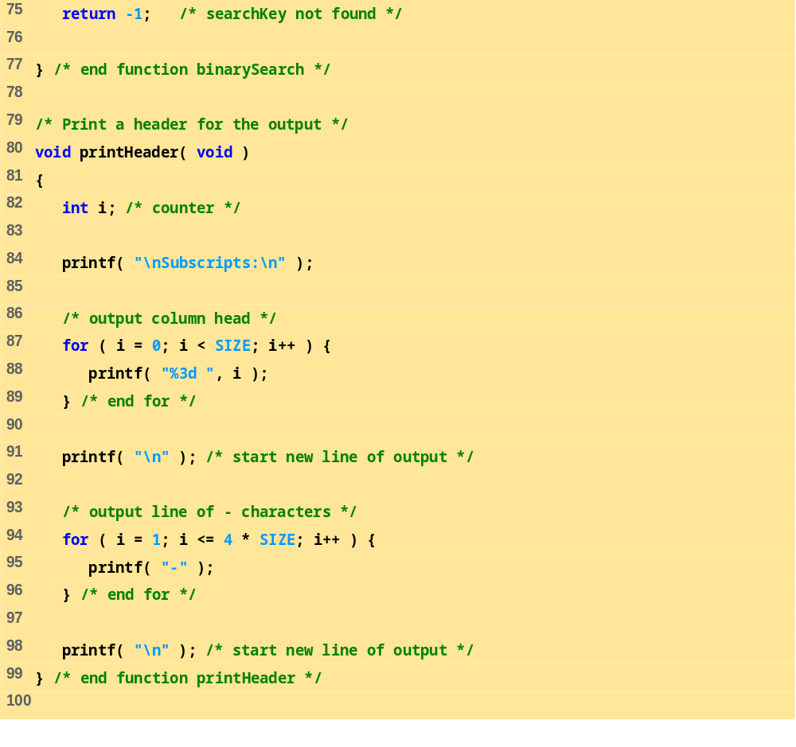
fig06_19.c (Part 4 of 5)

Slide 62
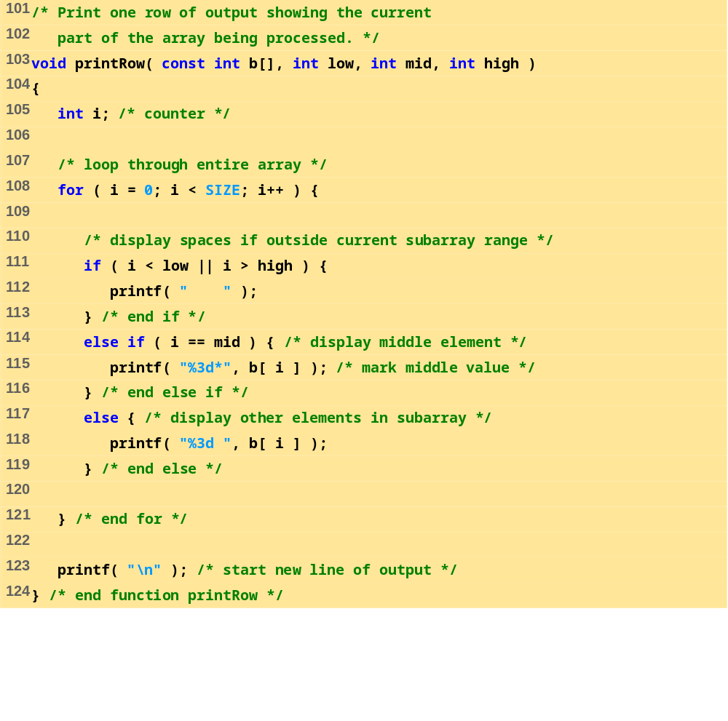
fig06_19.c (Part 5 of 5)

Slide 63
Program Output
Enter a number between 0 and 28: 25
Subscripts:
0 1 2 3 4 5 6 7 8 9 10 11 12 13 14
------------------------------------------------------------
0 2 4 6 8 10 12 14* 16 18 20 22 24 26 28
16 18 20 22* 24 26 28
24 26* 28
24*
25 not found
Enter a number between 0 and 28: 8
Subscripts:
0 1 2 3 4 5 6 7 8 9 10 11 12 13 14
------------------------------------------------------------
0 2 4 6 8 10 12 14* 16 18 20 22 24 26 28
0 2 4 6* 8 10 12
8 10* 12
8*
8 found in array element 4

Slide 64
Program Output (continued)
Enter a number between 0 and 28: 6
Subscripts:
0 1 2 3 4 5 6 7 8 9 10 11 12 13 14
------------------------------------------------------------
0 2 4 6 8 10 12 14* 16 18 20 22 24 26 28
0 2 4 6* 8 10 12
6 found in array element 3

Slide 65
6.9 Multiple-Subscripted Arrays
Multiple subscripted arrays
  Tables with rows and columns (m by n array)
  Like matrices: specify row, then column
Column 0
Column 1
Column 2
Column 3
Row 0
a[ 0 ][ 0 ]
a[ 0 ][ 1 ]
a[ 0 ][ 2 ]
a[ 0 ][ 3 ]
Row 1
a[ 1 ][ 0 ]
a[ 1 ][ 1 ]
a[ 1 ][ 2 ]
a[ 1 ][ 3 ]
Row 2
a[ 2 ][ 0 ]
a[ 2 ][ 1 ]
a[ 2 ][ 2 ]
a[ 2 ][ 3 ]
Column subscript
Array name
Row subscript

Slide 66
6.9 Multiple-Subscripted Arrays
Initialization
  int b[ 2 ][ 2 ] = { { 1, 2 }, { 3, 4 } };
  Initializers grouped by row in braces
  If not enough, unspecified elements set to zero
    int b[ 2 ][ 2 ] = { { 1 }, { 3, 4 } };
Referencing elements
  Specify row, then column
    printf( "%d", b[ 0 ][ 1 ] );
1 2
3 4
1 0
3 4

Slide 67
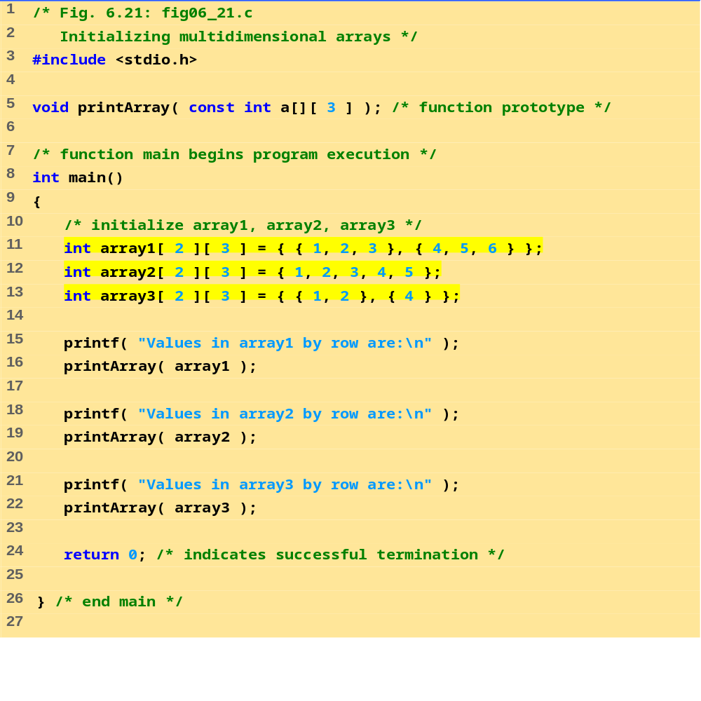
fig06_21.c (Part 1 of 2)

Slide 68
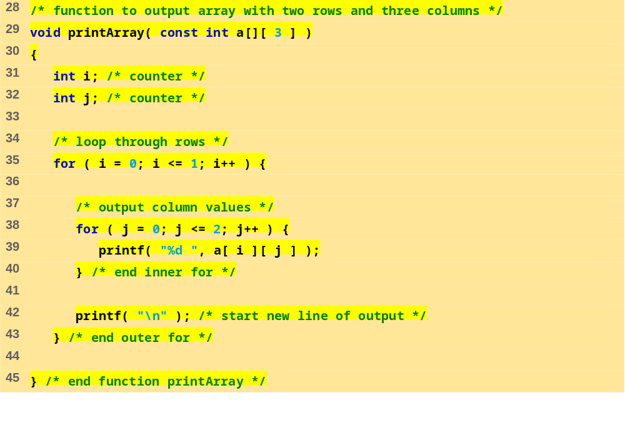
fig06_21.c (Part 2 of 2)
Program Output
Values in array1 by row are:
1 2 3
4 5 6
Values in array2 by row are:
1 2 3
4 5 0
Values in array3 by row are:
1 2 0
4 0 0

Slide 69
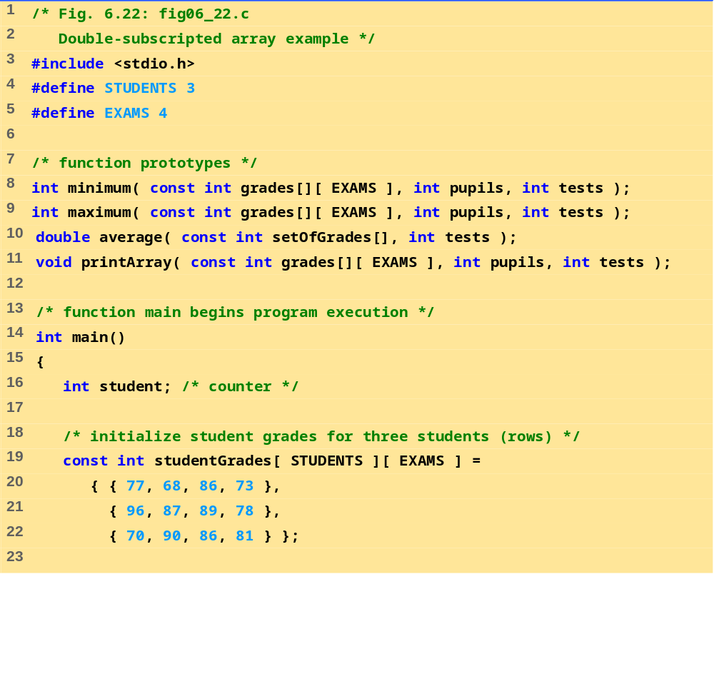
fig06_22.c (Part 1 of 6)

Slide 70
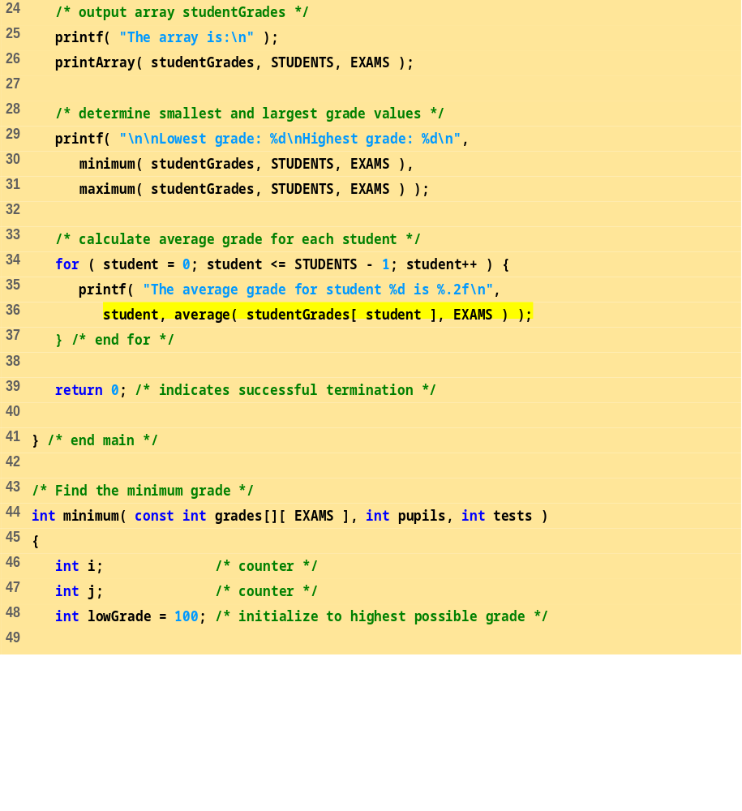
fig06_22.c (Part 2 of 6)

Slide 71
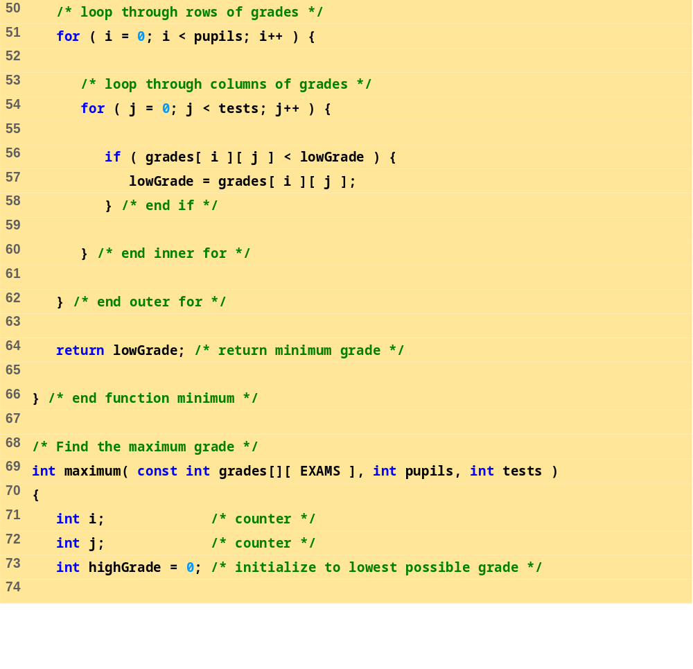
fig06_22.c (Part 3 of 6)

Slide 72
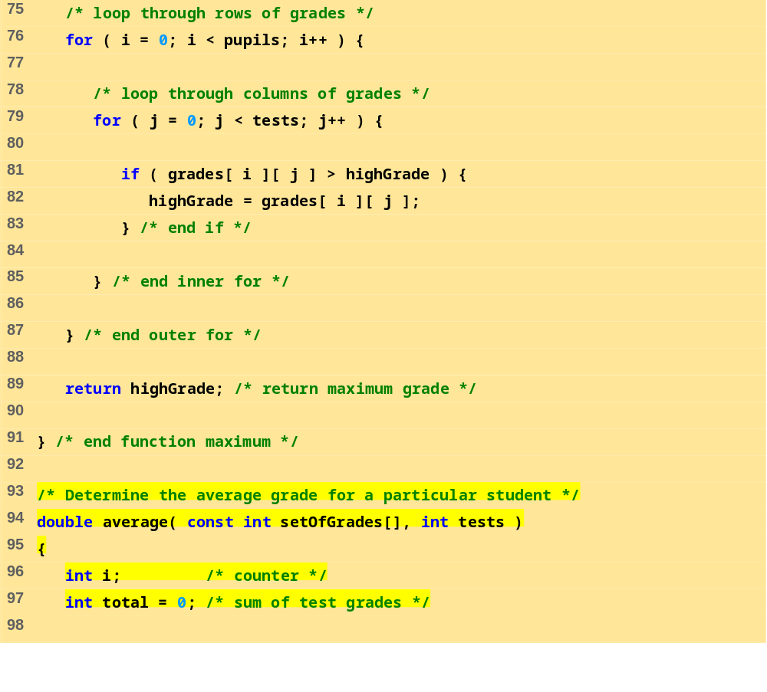
fig06_22.c (Part 4 of 6)

Slide 73
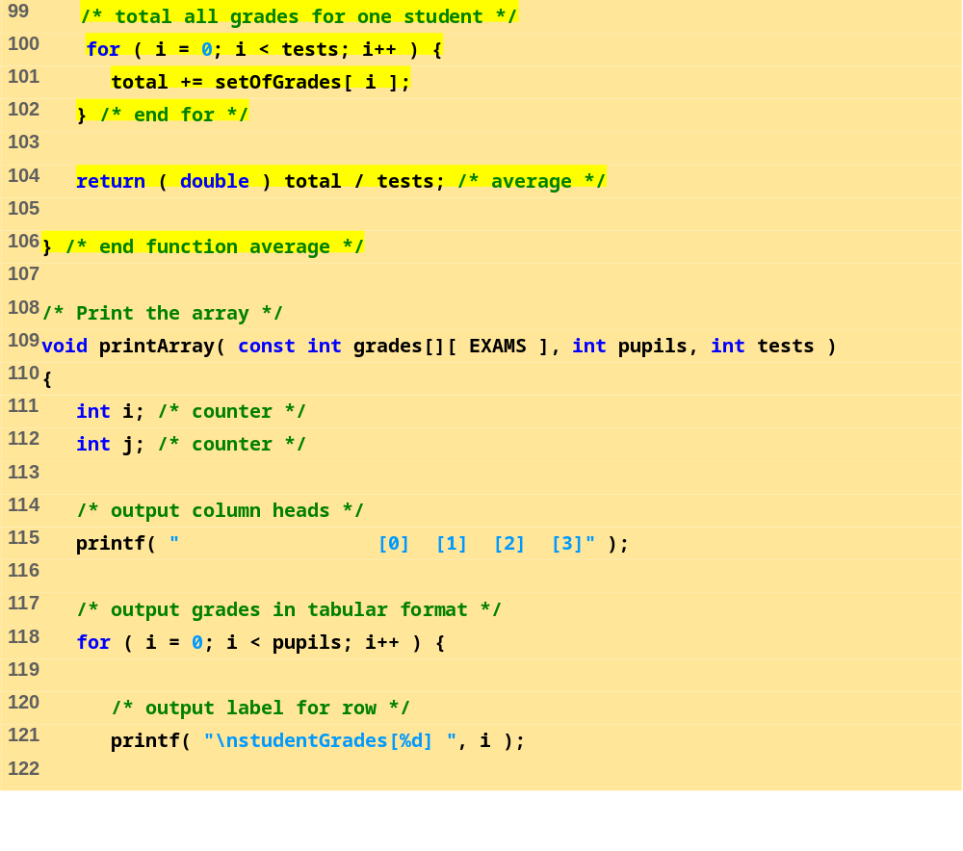
fig06_22.c (Part 5 of 6)

Slide 74
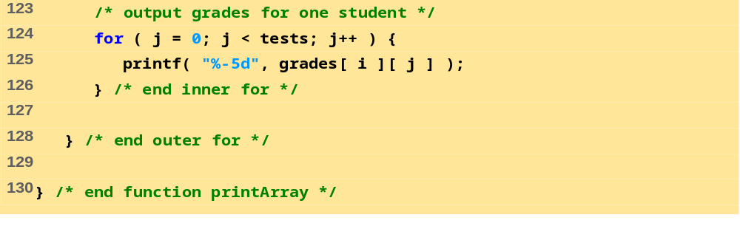
fig06_22.c (Part 6 of 6)
The array is:
[0] [1] [2] [3]
studentGrades[0] 77 68 86 73
studentGrades[1] 96 87 89 78
studentGrades[2] 70 90 86 81
Lowest grade: 68
Highest grade: 96
The average grade for student 0 is 76.00
The average grade for student 1 is 87.50
The average grade for student 2 is 81.75

